Slide 1
Predefined Plugins
October 18, 2013
Notes:
Guidewire training materials contain Guidewire proprietary information that is subject to confidentiality and non-disclosure agreements. You agree to use the information in this manual solely for the purpose of training to implement Guidewire software solutions. You also agree not to disclose the information in this manual to third parties or copy this manual without prior written consent from Guidewire. Guidewire training may be given only by Guidewire employees or certified Guidewire partners under the appropriate agreement with Guidewire.

Slide 2
Describe the basic functionality of Guidewire plugins
Determine the methods needed for a given predefined plugin
Write predefined plugins in Gosu
Write predefined plugins in Java
Register and deploy plugins

Slide 3
Overview of Guidewire plugins
Determining plugin requirements
Writing plugins in Gosu
Writing plugins in Java
Registering and deploying plugins

Slide 4
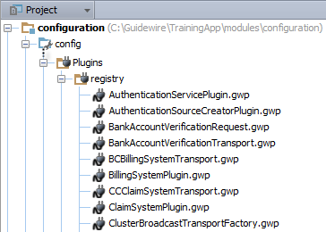
Plugin
Often defines integration point with external system(s)
.gwp file
…\config\plugin\registry\
Specifies Gosu or Java class
Defined additional parameters
Gosu or Java class
Contains a set of methods called by internal code to execute application functionality
Code executes in…
the Guidewire application Java Virtual Machine (JVM) process
a user context or outside of user context
the current transaction bundle
Notes:
In Guidewire, a plugin is a Gosu or Java class that contains a set of methods called by internal code to execute application functionality. Guidewire plugins run in the same Java Virtual Machine (JVM) process as the Guidewire application itself.
A plugin might do the required work by itself or it might interact with other external systems. If a plugin must retrieve data from an external system, the integration point must be synchronous. Guidewire strongly recommends that you carefully consider response time, including network response time, as you write your plugin implementations.
In some cases, calls to a plugin block the user from doing further work until the call is complete. End users should not wait for long responses from the application. Predefined plugins should perform quickly and synchronously.

Slide 5
Implemented plugins behaviors
All applications
User authentication
Geocoding
Number generation for significant entities
Document production and storage
ClaimCenter
Policy search
New Claim Wizard
PolicyCenter
Vehicle identification number (VIN) search
BillingCenter
Commission calculation
Notes:
Geocoding is the process of finding geographic coordinates from geographic data, such as street addresses or postal codes, and using that information for various purposes, for example:
Verifying the accuracy of an address
Executing proximity searches (such as finding all auto repair ships within a 10-mile radius of a damaged auto's location)
Providing driving directions
Number generation is done for:
ClaimCenter's Claim entity
PolicyCenter's PolicyPeriod and Job entities
Seven entities in BillingCenter: Account, CollateralRequirement, Disbursement, Invoice, Statement, Transaction, TroubleTicket

Slide 6
Types of plugins
Predefined plugins
Used to implement customizable behavior for predefined points in the application
Messaging plugins
Used to send messages to external systems and process the resulting replies
Startable plugins
Used to listen for incoming messages and processes them asynchronously
Notes:
Calls to predefined plugins block the user from doing further work. Calls to messaging plugins and startable plugins occur outside of a user context and do not block any user from doing further work.

Slide 7

Plugin application scope
Internal to Guidewire
Number generator plugin example
Generates a unique, sequential number for claims, policies, or accounts
Application logic internal to Guidewire
External system integration
Authentication plugin example
Interacts with an external system such as Active Directory, Single Sign On (SSO) or LDAP Server
Number Generator
Authentication
LDAP Server
Notes:
Many plugins execute behaviors that are typically internal to Guidewire. For example, the number generator plugin generates a unique, sequential number for claims, policies, or accounts and typically uses logic entirely within Guidewire. Other plugins execute behaviors that involve communication with external systems. For example, the authentication plugin typically interacts with an external LDAP server.
The term "plugin" should not be considered synonymous with "integration". Although many plugins are used for external system integration, some are used exclusively for internal processing. The number of non-integration plugins varies from application to application.
When a predefined plugin does integration work, the data exchange is typically outbound (initiated by Guidewire) and synchronous. All plugins are documented in the Integration Guide (whether they typically involve integration with external systems or logic that's entirely internal to Guidewire).

Slide 8
Plugin interfaces
Every plugin class must implement at least one interface
Interface varies based on the plugin to be implemented
Interface contains methods that internal code will call
Authentication Service plugin example:
Must implement the AuthenticationServicePlugin interface
Calls authenticate() and setCallback()
class AcmeAuthenticationPlugin implements AuthenticationServicePlugin {
…
function authenticate() {…}
…
function setCallback() {…}
…
}
Notes:
An interface is a set of properties and methods whose purpose is to define how software elements interact without identifying any specific implementation. An interface defines property and method names and return values. An interface does not define property or method implementations.

Slide 11
Plugin source code
AcmeAuthenticationPlugin.gs
AcmeAuthenticationPlugin.java
Gosu Plugin
Code efficiently using Guidewire Studio
Native debugging within Guidewire Studio
Easy access to application API
May require specific placement in plugins directory
Java Plugin
Third party Integrated Development Environment (IDE)
Very specific requirements for placement in plugins directories
Notes:
You can write your plugin implementations in Gosu or Java. By using Gosu, you get full advantage of Gosu language features. For example, Gosu blocks, Gosu collection enhancement methods, native access to data model types, intelligent code completion after you type the period (.) character, and type inference. These features help you quickly write concise and easy-to-maintain code.
Guidewire recommends all new plugins be written in Gosu. The main reasons for this recommendation are speed of development and code conciseness.
See documentation regarding the very specific rules and requirements for Java plugin class placement in plugins directories.

Slide 12
Steps to implement Gosu plugins
Determine plugin requirements
Write plugin class in Guidewire Studio
Create or modify and then configure the plugin registry file
Deploy the changes

Slide 13
Steps to implement Java plugins
Determine plugin requirements
Write plugin class in third party Integrated Development Environment (IDE)
Requires specific JAR references
Compile class in IDE
Copy the Java class and libraries to the appropriate Guidewire plugins directory
Create or modify and then configure the plugin registry file
Deploy the changes
!
You must use a separate IDE for Java development.
Do NOT create Java classes directly in Guidewire Studio.

Slide 14
Overview of Guidewire plugins
Determining plugin requirements
Writing plugins in Gosu
Writing plugins in Java
Registering and deploying plugins

Slide 15
Use case: Exchange rate calculation
$
1.301
€
€
0.769
$
ExchangeRate Plugin
TrainingApp supports multiple currencies and needs to be able to convert values from one currency to another
Exchange rates are retrieved through a plugin
Notes:
Every predefined plugin meets a specific business need and therefore has unique business-specific issues tied to it. The focus of this lesson is the implementation work common to all plugins. Therefore, the remainder of this lesson focuses on TrainingApp's exchange rate plugin, a plugin used to support currency conversion. This plugin has been chosen because the business issues are straight-forward and the discussion can focus on the plugin technology itself.
The more commonly implemented plugins involve additional concerns. Some of these plugins and their issues are discussed in later lessons. (For example, the "Authentication Integration" lesson discusses the authentication plugin and the mechanics of authentication.)

Slide 16
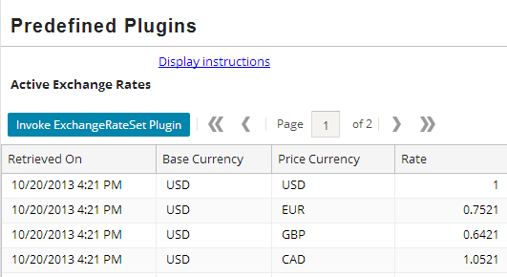
Use case: Exchange rate requirements
Create an exchange rate set that includes one exchange rate for every typekey currency
TrainingApp
Predefined Plugins
Click Invoke ExchangeRateSet Plugin
Interface to implement:
IExchangeRateSetPlugin
Methods to implement:
createExchangeRateSet()
Notes:
In the ContactManager base application, exchange rates are not retrieved. By calling the gw.api.util.CurrencyUtil.invokeMarketExchangeRateSetPlugin() method in Gosu code, you can trigger the plugin.
In ClaimCenter, you can trigger exchange rate retrieval both manually and through the exchangerate batch process. PolicyCenter and BillingCenter do not currently make use of exchange rates.

Slide 17
Step 1: Gosu plugin requirements
You must determine:
What interface(s) must the plugin implement?
What methods are included in the interface(s)?
When are the methods called?
What issues should you consider when implementing the plugin?
Does the plugin reference third party JARs?
Resources to consult:
Integration Guide
Gosu API and docs
Notes:
The Integration Guide for each product describes all the plugins in the plugin overview chapter. In some cases, there are numerous issues around a given plugin, and therefore an entire chapter in the documentation is devoted to it.

Slide 18
Step 1: Java plugin requirements
You must determine:
Using deprecated API?
Using Guidewire 8.0 API?
Referencing entity or typelists?
When are the methods called?
What issues should you consider when implementing the plugin?
Resources to consult:
Integration Guide
JavaDocs for deprecated API
JavaDocs for JARS
Notes:
To regenerate the libraries for the legacy API, continue to use the same gwcc regen-java-api command as in previous releases. However, there you must add an additional flag on the tool to generate the deprecated Java libraries in addition to the 8.0 Java API libraries. Also, Guidewire application now generate the libraries and Javadoc for the deprecated API in a slightly different location than in previous versions.
Although the older API is deprecated, you can continue to use the deprecated API in this release while you start to upgrade your code to the new API. You can use Java code from the deprecated API and code using the new API at the same time for different plugin interfaces. Be sure that for each plugin interface and Java class, you follow deploy requirements for each API style (deprecated API or new API).

Slide 19
Overview of Guidewire plugins
Determining plugin requirements
Writing plugins in Gosu
Writing plugins in Java
Registering and deploying plugins

Slide 20
Step 2: Write Gosu plugin class
2a. Create the plugin class in the correct directory
2b. Implement the required interface(s)
2c. Replace method stubs with actual code

Slide 21
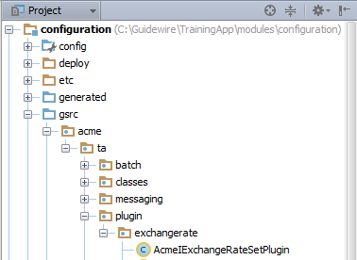
Step 2a: Create the plugin class
Create Gosu plugin class in a package located in /gsrc
Use a package naming convention recommendation
<company>.<app_code>.plugin.<functional_area>
Use plugin naming convention recommendation
<meaningfulName><interfaceImplemented>
Notes:
Packages
To create a new package, right-click the parent and select New --> Package. Then, provide a name for the package.
When you are using Studio to create your new class, create it within a root package that you created (such as the acme package above).
Do not create your own plugins within the built-in gw.* package hierarchy or the plugins.* package hierarchy in Studio. These packages have special functionality reserved for the Guidewire application.
Classes
To create a new class, right-click the parent package and select New -- >Gosu Class. Then, provide a name for the class. Studio automatically creates a shell class for you, including a construct method. Many plugins do not require a construct method. For these plugins, it can be omitted.

Slide 22

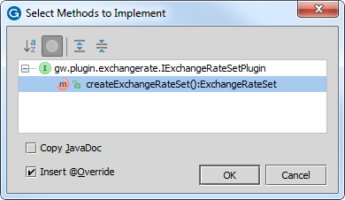
Step 2b: Implement required interface(s)
1 package acme.ta.plugin.exchangerate
2
3 uses gw.plugin.exchangerate.IExchangeRateSetPlugin
4 5 class AcmeIExchangeRateSetPlugin implements IExchangeRateSetPlugin {
6 override function createExchangeRateSet(): ExchangeRateSet {
7 return null
8 }
9 }
Implement the interface
ALT+ENTER (1) to import the class, e.g., uses statement
ALT+ENTER (2) to implement methods
Notes:
Recall that the first step of plugin implementation is to determine the plugin requirements. This includes the name of the interface to implement, which can be determined from either the Integration Guide or the Java API Reference.
You must manually type in "implements" and the name of the appropriate interface. Next, click the interface name and press ALT+ENTER. The first ALT+ENTER adds a "uses" statement to the class that references the interface as in Line 3.
The second ALT+ENTER adds method stubs for all methods that need to be declared in the plugin (as shown in lines 5 through 8).
A plugin class can implement more than one interface. To implement multiple interfaces, list each interface after the "implements" keyword and separate interfaces with a comma.

Slide 23
Step 2c: Replace method stubs with code
6 override function createExchangeRateSet(): ExchangeRateSet {
7 // Create and initialize new exchange rate set
…9 var erSet = new ExchangeRateSet()
10 erSet.Name = "Acme ExchangeRateSet " + DateUtil.currentDate()
12 erSet.MarketRates = true
13 erSet.EffectiveDate = currentDate()
…36 return erSet
37 }
Every public method from the interface must exist
Some methods can be left as stubs that do nothing
Create private methods within the plugin
Call your private methods from public methods
Notes:
For some plugins, method stubs can remain as is. This occurs when a method is required, but is not required to return a value, set a property, or call an internal method. For any plugin, you can create and call additional (non-public) methods. For example, an exchange rate plugin might have a private method called "extractRate" which takes a "to" currency and a "from" currency, sends them to a third-party web service, and gets a rate in response.

Slide 24
Overview of Guidewire plugins
Determining plugin requirements
Writing plugins in Gosu
Writing plugins in Java
Registering and deploying plugins

Slide 25
Step 2: Write Java plugin class
gwXX regen-java-api
Generate the Guidewire 8.0 JAR files
Resulting JAR files in \java-api\lib\
Add JARS to project in third party IDE
Always reference plugin-1.0-SNAPSHOT.jar
For entities and typelists, reference related JARs
2a. Create the Java plugin class
2b. Implement required interface(s)
2c. Replace method stubs
2d. Compile the plugin class
2e. Copy the Java class file and libraries
Notes:
To regenerate the libraries for the legacy API, continue to use the same gwXX regen-java-api command as in previous releases. However, there you must add an additional flag on the tool to generate the deprecated Java libraries in addition to the 8.0 Java API libraries. Guidewire generates the libraries and Javadoc for the deprecated API in a slightly different location. Refer to documentation for more details.

Slide 26
Step 2a: Create the Java plugin class
1 package com.acme.ta.plugin.exchangerate;
2
…4 import gw.pl.currency.entity.ExchangeRate;
5 import gw.pl.currency.entity.ExchangeRateSet;
6 import gw.pl.currency.typekey.Currency;
7 import gw.pl.persistence.core.Bundle;
8 import gw.plugin.exchangerate.IExchangeRateSetPlugin; …14 import java.util.Date;
…16 public class AcmeIExchangeRateSetPlugin implements IExchangeRateSetPlugin {
17
18 public ExchangeRateSet createExchangeRateSet() {
Guidewire naming convention recommendation:
com.<company>.<app_code>.plugin.<functional_area>
Plugin name typically ends in the name of the interface the plugin implements
Notes:
With certain IDEs, you must manually create the package folders. In other IDEs, you can specify the fully qualified class name and the packages (file directories) will be automatically created for you.

Slide 27
Step 2b: Implement required interface(s)
1 package com.acme.ta.plugin.exchangerate;
2
…16 public class AcmeIExchangeRateSetPlugin implements IExchangeRateSetPlugin {
17
18 public ExchangeRateSet createExchangeRateSet() {
Implement the interface(s) (line 16)
Every public method from the interface must exist
Some methods can be left as stubs that do nothing
Create private methods within the plugin and call them from the public methods
Notes:
The plugin-1.0-SNAPSHOT.jar contains the InternalPlugin interface which all other plugin interfaces extend. Your Java IDE must reference this JAR. If working with entities and typelists, be sure to include these JARs as well.
For some plugins, method stubs can remain as is. This occurs when a method is required, but it isn't required to do anything.

Slide 28
Step 2c: Replace method stubs
18 public ExchangeRateSet createExchangeRateSet() {
19 // Java plugin scope is within context of current bundle
20 Bundle currentBundle = Transaction.getCurrent();
21 Date today = new Date();
22 // Create and initialize new exchange rate set
23 ExchangeRateSet erSet = ExchangeRateSet.TYPE.newInstance( currentBundle);
24 erSet.setName("acme ExchangeRateSet " + today.toString());
25 erSet.setMarketRates(Boolean.TRUE);
26 erSet.setEffectiveDate(today);
27 // Query external system web service for exchange rates
Line 20: Plugin code runs in the current transaction bundle
Line 23: Syntax specific for creating new entity
entity.TYPE.newInstance(bundle)
Syntax specific for creating customer entity extension
(EntityExt) entity.TYPE.newInstance(bundle)
Notes:
For any plugin, you can create and call additional (non-public) methods. For example, an exchange rate plugin might have a private method called "extractRate" which takes a "to" currency and a "from" currency, sends them to a third-party web service, and gets a rate in response.

Slide 29
Step 2d: Compile the plugin class
Compile the class in the third party IDE
Many IDEs compile to an out directory
…\projectname\out\production\
Identify
The plugin .class file
Any associated third party JAR files

Slide 30
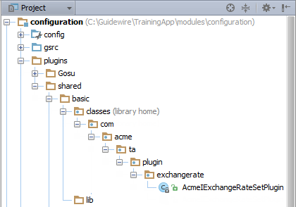
Step 2e: Copy Java to shared
Copy Java class and JARs to shared directory
When referenced by multiple plugins and non-plugin classes
Subdirectories must match the Java class package hierarchy
Place .class files in shared
…/configuration/plugins/SHARED/basic/classes/
Place referenced JAR Libraries in shared
…/configuration/plugins/SHARED/basic/lib/
Do NOT copy Guidewire JAR files to lib
Notes:
The directories and files detailed in the screenshot are NOT in the TrainingApp plugins directory.
In certain cases, when the Guidewire application already defines a plugin directory, then you should use the plugin directory if your class overrides or extends the implementation.
The directory and its subdirectories must be created manually. Each subdirectory may contain a classes directory and a lib directory.
When copying your Java class into Guidewire, copy the entire directory structure appropriate to the packages of the class.
Do not copy Guidewire JAR files to the lib folder. Only copy third party JAR files to the lib folder that are used by your plugin.
Carefully deploy Java class files and JAR files. Putting files in other locations is dangerous and unsupported. Refer to documentation for more details about Java classes.

Slide 31
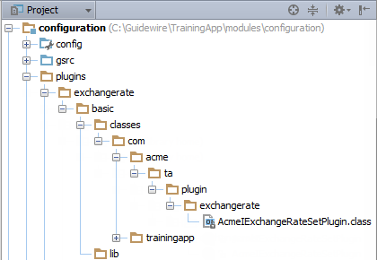
Step 2e: Copy Java to plugin directory
Define a plugin directory and copy Java class and JARs
When NOT referenced by multiple plugins and non-plugin classes
Subdirectories must match the Java class package hierarchy
Place .class files in plugin_dir
…/configuration/plugins/PLUGIN_DIR/basic/classes/
Place referenced JAR Libraries in plugin_dir
…/configuration/plugins/PLUGIN_DIR/basic/lib/
Do NOT copy Guidewire JAR files to lib
Notes:
The directories and files detailed in the screenshot are NOT in the TrainingApp plugins directory.
In certain cases, when the Guidewire application already defines a plugin directory, then you should use the plugin directory if your class overrides or extends the implementation.
The <plugindir> directory should be named after the functional area of the plugin. The "plugins" directory stores Java code referenced by the Guidewire application. The directory and its subdirectories must be created manually. It must be located in modules/configuration. Each subdirectory may contain a classes directory and a lib directory.
When copying your Java class into Guidewire, copy the entire directory structure appropriate to the packages of the class.
Do not copy Guidewire JAR files to the lib folder. Only copy third party JAR files to the lib folder that are used by your plugin.
Carefully deploy Java class files and JAR files. Putting files in other locations is dangerous and unsupported. Refer to documentation for more details about Java classes.

Slide 32
Overview of Guidewire plugins
Determining plugin requirements
Writing plugins in Gosu
Writing plugins in Java
Registering and deploying plugins

Slide 33
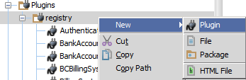
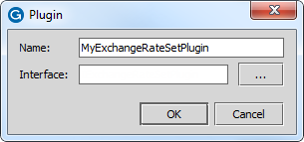
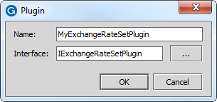
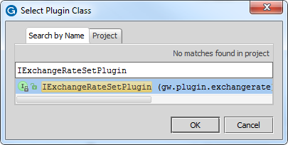
Step 3: Create the plugin registry file
Registry → New → Plugin
Specify name and select interface
Notes:
In the Project view, select the registry folder. The path is …\config\plugin\registry. Right click to open the context menu and select New → Plugin. In the Plugin dialog, specify the name of the new plugin registry file. Next, click the ellipse button to select the interface. In the Select Plugin Class dialog, select the required class.
In many cases, the plugin definition already exists in the project and it is not necessary to create a new plugin file!
Each plugin registry is a .gwp file that is in XML document. All plugin files are created in <install>\modules\configuration\config\plugin\registry.

Slide 34
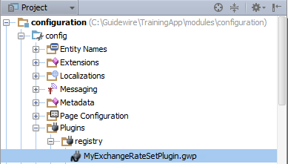
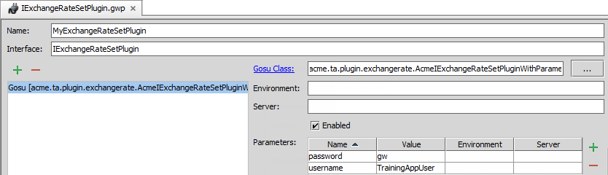

Step 3a: Configure Gosu plugin
In Project View, open .gwp
Plugin Editor
Add Plugin type
Specify class
Mark enabled
Define parameters
2
1
3
4
Notes:
The screenshot example shows a Gosu plugin. If the plugin is implemented as Gosu and must be Java, click Remove (-) an then select Add (+) Java Plugin.
Guidewire only reads the files in the plugin registry at server startup. To deploy changes to registry entries, you must restart the server.
For predefined plugins, a given registry file can point to only one class at a time. There can be multiple entries for startable and messaging plugins.

Slide 35
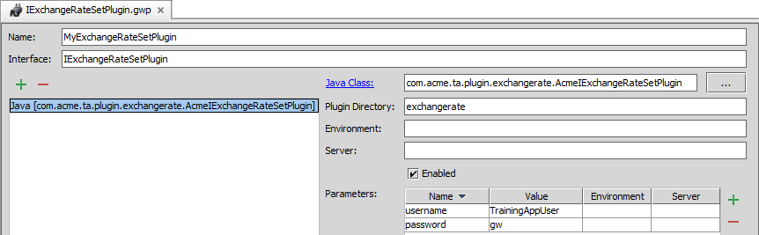

Step 3a: Configure Java plugin
In Project View, open .gwp
Plugin Editor
Add Plugin type
Specify class
Specify Directory
Mark enabled
Define parameters
2
1
3
4
5
Notes:
The screenshot example shows a Java plugin that is not shared. If the plugin is implemented as Java and must be Gosu, click Remove (-) and then select Add (+) Gosu Plugin.
For non-shared Java plugins, you must specify the Plugin Directory. Guidewire only reads the files in the plugin registry at server startup. To deploy changes to registry entries, you must restart the server.
For predefined plugins, a given registry file can point to only one class at a time. There can be multiple entries for startable and messaging plugins.

Slide 36

Plugin Parameters
Specify values that can be passed into a plugin at the registry level
Useful for varying plugin behavior without changing the plugin code itself
Example:
Testing environment compared to a production environment
Plugin class must implement InitializablePlugin interface and setParameters() method
Notes:
Plugin parameters can be useful in the following situations:
You want a single plugin implementation to have different behavior over time (such as changing the user name or password needed to access a remote system).
You want a single plugin implementation to have different behavior in a development environment compared to a production environment.
You want a single plugin implementation to have different behavior on different servers in a clustered environment.

Slide 37
Reading plugin parameters
1 package acme.ta.plugin.exchangerate
2
3 uses gw.api.system.database.SequenceUtil
4 uses gw.plugin.InitializablePlugin
5 uses gw.plugin.exchangerate.IExchangeRateSetPlugin
…7 uses java.util.Map
8
…13 class AcmeIExchangeRateSetPluginWithParameters implements IExchangeRateSetPlugin, InitializablePlugin {
14 override function createExchangeRateSet():ExchangeRateSet {
…40 }
43 override function setParameters(parameters:Map<Object,Object>) {
44 var userName = parameters.get("username")
45 var password = parameters.get("password")
46 print("Retrieving currency rates as " + userName + " with password " + password)
47 }
Notes:
The AcmeIExchangeRatePluginWithParameters class shown above is available in TrainingApp, but this implementation of the plugin is not in use.
To make use of plugin parameters, the plugin must implement the InitializablePlugin interface and implement the setParameters method.
The input for this method is a Map object that contains name/value pairs representing the names and values passed in from the plugin registry's Parameters table. The setParameters method is called only once, before the first use of the plugin.

Slide 38
Step 4: Deploy plugin and code
Restart Server
Make Project or Reload Changed Classes
New Gosu plugin class
New or modified
Java plugin class
Plugin registry file
Modified Gosu plugin class
GWP
New Java or Gosu Plugin Class
Plugin File
Modified Gosu Class
Notes:
If you implement your message reply plugin in Java, then you will need to compile the Java class and recopy it into the proper Guidewire directory structure. Then, you must restart the server.
Guidewire only reads the contents plugin registry directory at server startup. You must restart the server when you create or modify plugin registry files.
You must restart the server when you create a new Gosu plugin class. For modified Gosu plugin classes, you can Make Project or Reload Changed classes.
You can restart the server from Studio by stopping a running server (debug mode is ok) and after the server stops, then running the server again in either Run or Debug mode.

Slide 39
Describe the basic functionality of Guidewire plugins
Determine the methods needed for a given predefined plugin
Write predefined plugins in Gosu
Write predefined plugins in Java
Register and deploy plugins

Slide 40
Identify if each statement is true or false.
Plugins implement methods that are called by internal code.
Plugins must be written in Gosu.
A plugin class must contain a predetermined set of methods based on the business need it serves.
Plugins are used exclusively for external application integration.
What is the purpose of a plugin registry entry?
Do you need to restart the server when you:
Modify code in an existing Gosu plugin?
Modify code in an existing Java plugin?
Modify a plugin registry entry?
Notes:
Answers
1a) True
1b) False (Guidewire recommends that they be written in Gosu, but they can be written in Java.)
1c) True
1d) False (They are also used to execute tasks exclusively within the Guidewire application.)
2. The plugin registry entry identifies the plugin class to use for a given set of internally called methods and initialization parameters that may be used to affect the plugin's behavior
3a) No, you do not to restart the server when you make changes to a top level Gosu plugin class. However, you should reload the metadata using Alt+ Shift+ L from the user interface.
3b) Yes, you need to restart the server when you make changes to a top level Java plugin class.
3c) Yes, you need to restart the server when change a plugin registry entry because plugin registry entries are initialized only during the server application start-up.

